Slide 1
Strengthening and Managing your organization
2016 Market Singapore Leadership School
董宥均 Stacy Tung

Slide 2
Are you ready to change?

Slide 3
What’s different?

Slide 4
Attitude?

Slide 5
knowledge?

Slide 6
goals?

Slide 7
Action plans?

Slide 8
Retail yourself?

Slide 9
Share your life?

Slide 10
Duplicate the system?

Slide 11
Build a dream team

Slide 12
Create a team culture
If you don’t have
GREAT
CULTURE
You won’t attract
GREAT PEOPLE

Slide 13
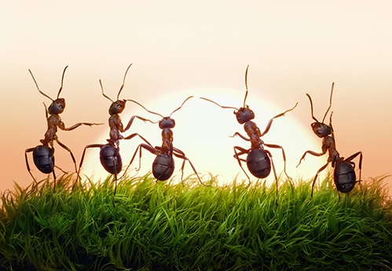
You are not alone
Work hard in silence
Let your success be your noise

